Slide 1

Singly linked list operations

Slide 2

Insertion
Insertion at beginning
new node is inserted in the front of already existing linked list.
have to follow some steps:
First we will create a new node(temp)and store the data into the data part.
Now we will point the link part of the new node with the first node(head) of existing linked list
After that we will make new node(temp) as the first node(head)

Slide 3
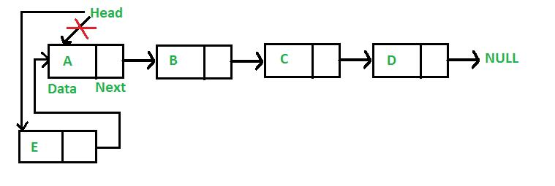
Insertion

Slide 4
Insertion
Insertion at the beginning
1) Start
2)Declare a structure variable , temp
3) Allocate memory to temp
4) Read value to be inserted as temp->data
5) Set temp->next =head
6) Set head=temp
7) stop

Slide 5
Insertion
Void insertfirst() {
Struct node *temp;
temp=(struct node*)malloc(sizeof (struct node) ;
printf( “enter value to be inserted”) ;
scanf(“%d”, &temp->data) ;
temp->next=head;
head=temp;
}

Slide 6
Insertion
2) Insert at end
The insertion of node at the end of singly linked list can have two cases:
First case when there is not even a single node in the list(list is empty).
In this case the condition (head==NULL) will be satisfied. Since, newnode is the only node that will be inserted in the list so we need to make this node point to the head pointer.
Second case when we have to add a node at the end of already existing linked list. In this we will use a loop to traverse to the end of list. So, we need to declare a temporary variable temp in order to traverse through the list.
At the end of the loop, the temp will be point to the last node of the list. The link part of the temp node will point to the newnode The link part of newnode will point to the null.

Slide 7
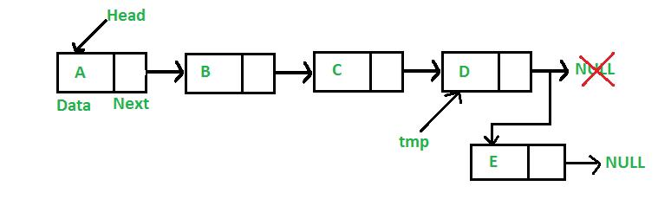
Insertion

Slide 8
Insertion
Insertion at end
1) Start
2)Declare structure variable pointers temp and newnode
3)Allocate memory to newnode
4)Read value to be inserted as newnode->data
5) Assign newnode->next=null
6) If head==null then go to step7 else Step8
7) Assign head as newnode, go to step12
8) Assign temp as head
9) Check if (temp->next! =null) repeat step10 else go to step11
10) Allocate temp as temp->next, go to step11
11) Assign temp->next as newnode
12) stop

Slide 12
Insertion
Void inserted() {
struct node *temp, *newnode;
newnode=(struct node*) malloc ( sizeof( struct node))
Printf (“Enter value to be inserted “) ;
Scanf(“%d”, &newnode->data) ;
newnode->next=null
If(head==null) {
head=newnode;}
else{
temp=head;}
While(temp->next! =null) {
temp=temp->next;}
temp->next=newnode;}}

Slide 13
Insertion
Traverse the Linked list upto position-1 nodes. Once all the position-1 nodes are traversed, allocate memory and the given data to the new node. Point the next pointer of the Temp to the next of ptr. Point the next pointer of to the ptr is assigned with Temp

Slide 14
Insertion
Insert at position
Step 01: Start
Step 02: Create a new node named ptr of Node type with the given data
Step 03: If head == NULL or pos == 1
Step 04: Call the function insertAtFirst()
Step 05: Go to step 17
Step 6: [End of If ]
Step 7: Else
Step 8: Create a temp of Node type and initialize it with head.
Step 9: [Initialize counter variable. ] Set i = 1
Step 10: Repeat Step 11 and 12 for i = 1 to i < pos – 1
Step 11: Set temp = temp→ next
Step 12: [Increase counter. ] Set i = i + 1
Step 13: [End of step 14 loop. ]
Step 14: Set ptr → next =temp->next
Step 15: Set temp→ next = ptr
Step 16: [End of Else block. ]
Step 17: Stop

Slide 15
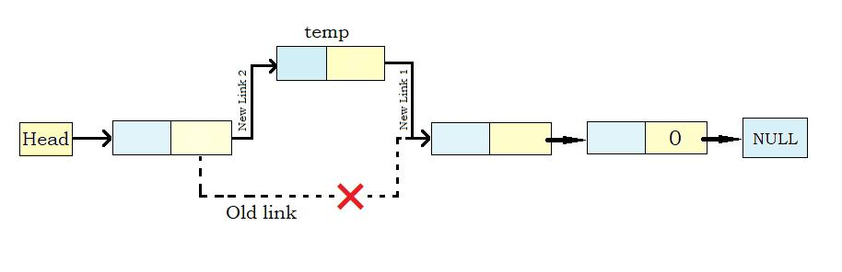
Insertion

Slide 16
Insertion
Void insertNode(int item) { struct node *ptr = (struct node *) malloc (sizeof(struct node)); struct node *temp; int i,loc; if(ptr == NULL) { printf(“\nOVERFLOW”); } else { printf(“\nEnter the location:\n”); scanf(“%d”,&loc); ptr->data = item; temp=head; for(i=0;i<loc;i++) { temp = temp->next; if(temp == NULL) { printf(“\nElement can’t be inserted.\n”); return; } } ptr ->next = temp ->next; temp ->next = ptr; printf(“\nNode inserted successfully!!”); } }

Slide 17
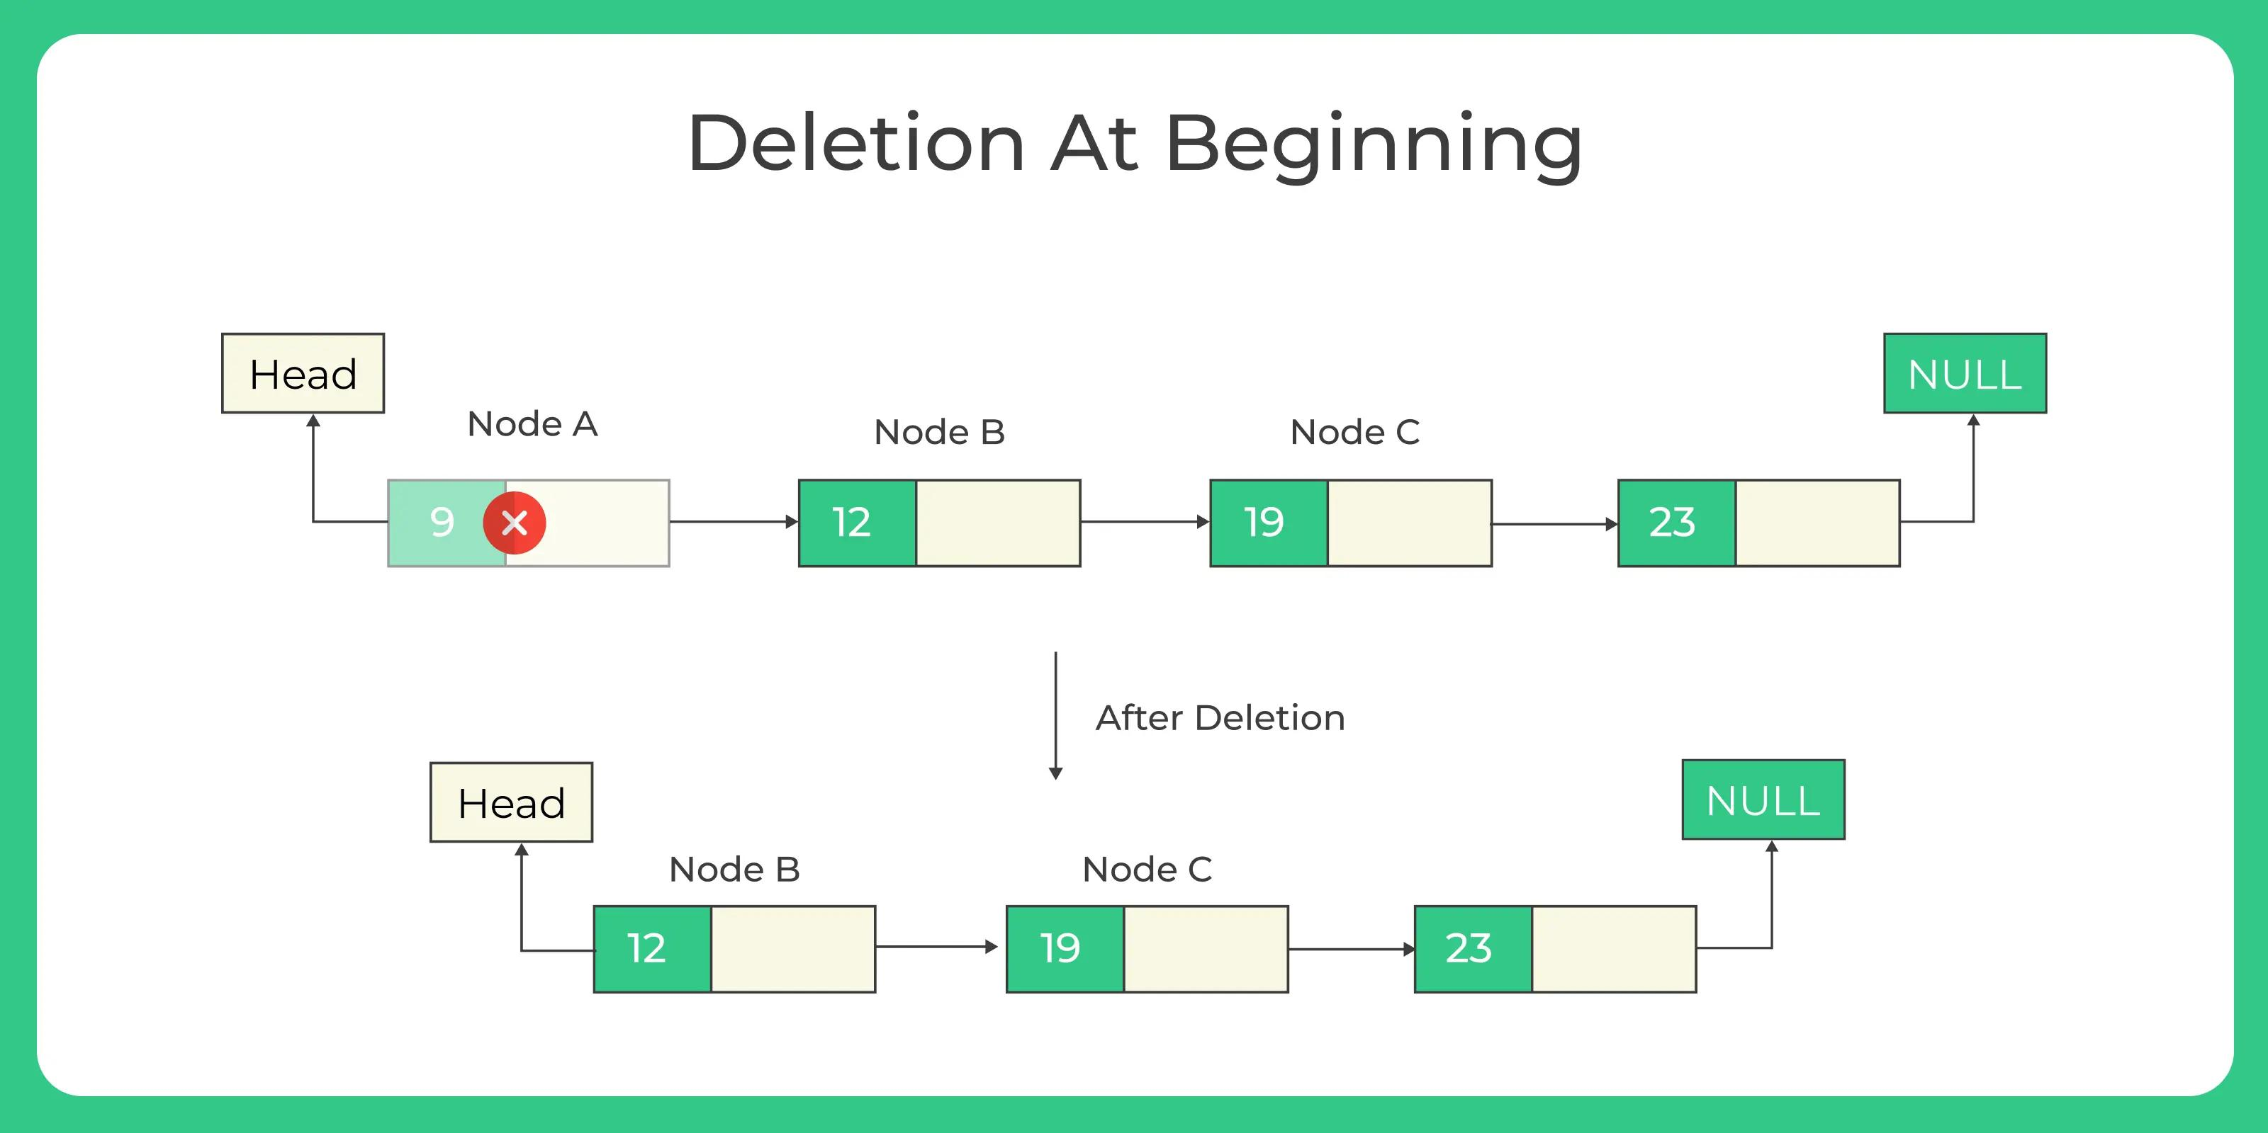
Deletion at first

Slide 18
Deletion
Deletion at first
1) Start
2)Declare a structure pointer temp
3)Check if head==null, then go to step4 else go to step5
4)Print linked list empty
5)Assign temp as head
6)Return temp->data
7)Assign head as temp->next
8)Delete temp
9)Stop

Slide 19
Deletion
Void deletefirst() {
struct node *temp;
If(head==Null) {
printf (“linked list empty “) ;}
else{
temp=head;
printf (“deleted item is”) ;
printf (“%d”, temp->data) ;
head=temp->next;
free(temp)
} }

Slide 20
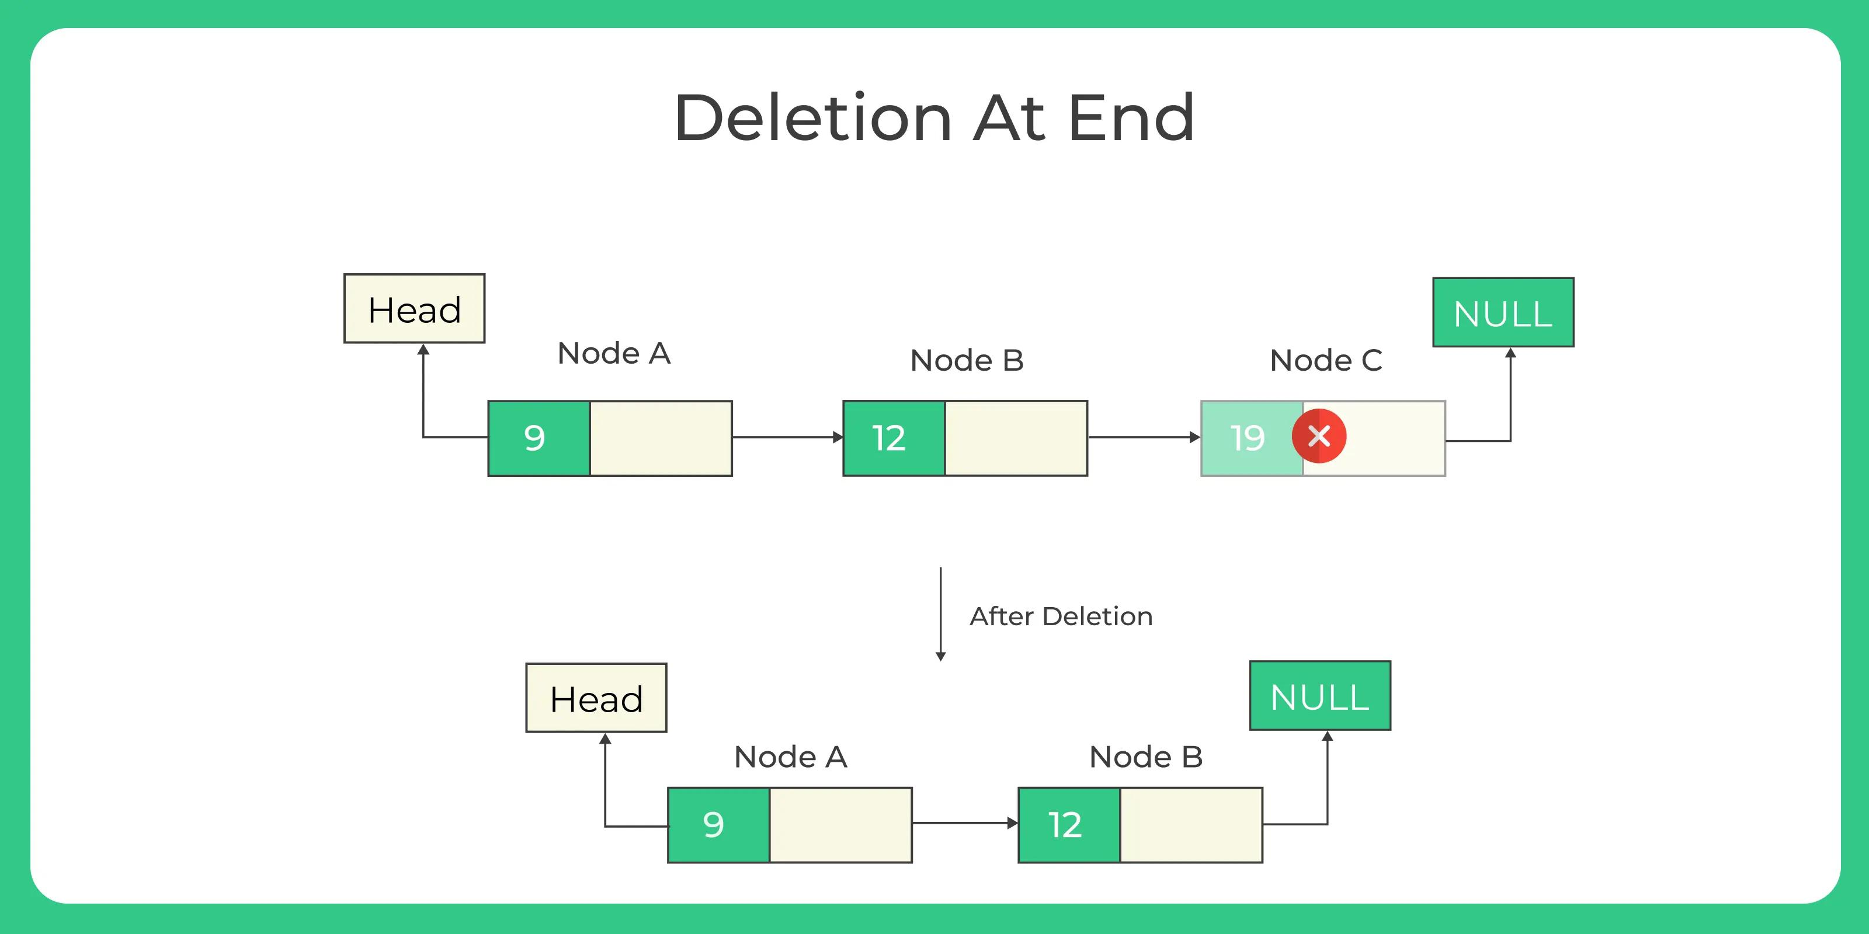
Deletion at end

Slide 21
Deletion
Deletion at end
1) Start
2)Declare a structure pointer temp and back
3) Check if (head=null) then go to step4 else go to step5
4) Print linked list empty, go to step 16
5) Initialize temp as head
6) Check if temp->next = null, then do step 7-9 else go to step 10
7) Return temp->data
8) Delete temp
9) Set head=Null
10) Check if temp->next! =null , then repeat step 11-12 else go to step13
11) Assign back as temp
12) Set temp=temp->next

Slide 22
Deletion
13) Return temp->data
14) Delete temp
15) Set back->next=null
16) Stop

Slide 23
Deletion
Void deleteend() {
struct node *temp, *back;
If (head=null) {
Print(“linked list empty”) ;}
Else{
temp=head;
If(temp->next==Null) {
Printf(“deleted element is %d”, temp->data) ;
free(temp) ;
Head=NULL}

Slide 24
Deletion
While(temp->next! =NULL) {
back=temp;
temp=temp->next;}
printf(“deleted element is%d”, temp->data) ;
free(temp) ;
back->next=NULL;}
}

Slide 25
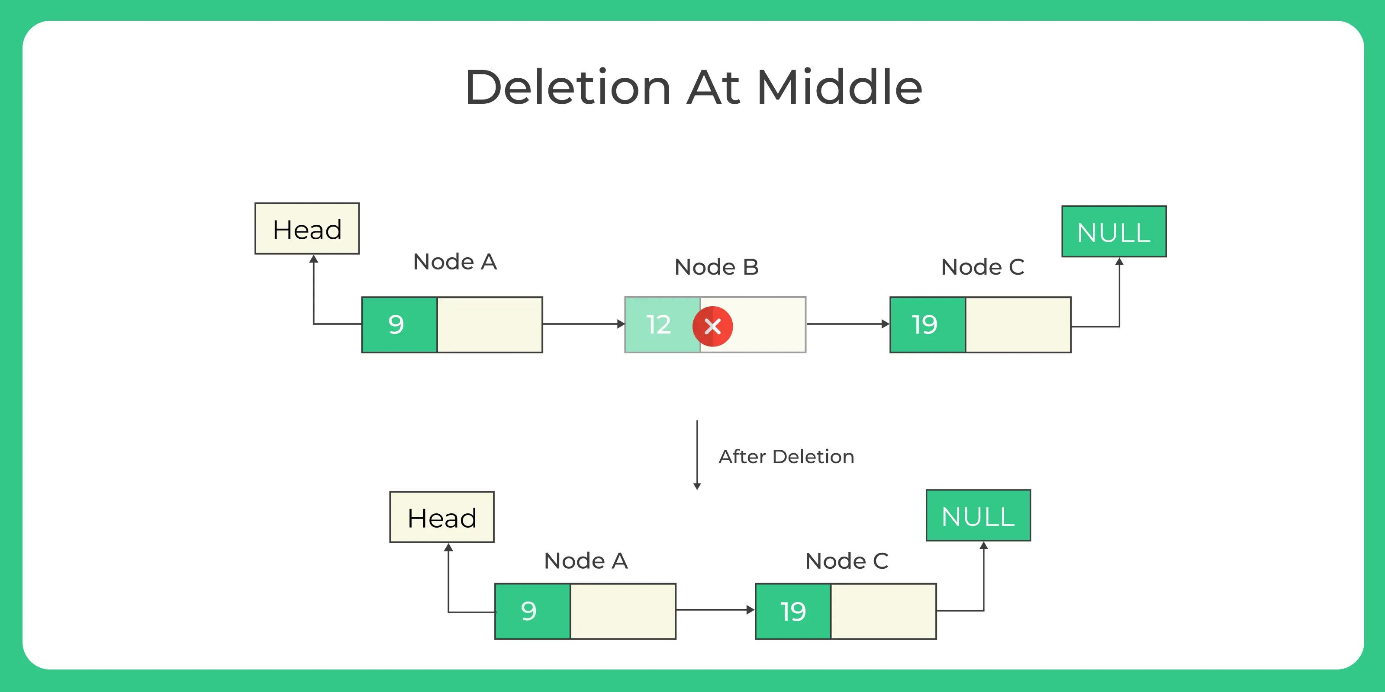
Deletion at position

Slide 26
Deletion-at Random position
Start
Declare a structure pointer *ptr, *ptr1.
Declare loc, read position from user
Initialize head=ptr
Set i=0
Check whether i<loc-1 repeat steps 7,8else go to step9
Assign ptr1=ptr
Set ptr=ptr->next
If ptr==Null, then go to step10
Print deletion not possible
Set ptr1->next=ptr->next
Delete ptr
Print deleted item

Slide 27
Deletion-at Random position
Void deleteAtRandom() { struct node *ptr,*ptr1; int loc,i; printf(“\nEnter the location of the node after which you want to perform deletion: \n”); scanf(“%d”,&loc); ptr=head; for(i=0;i<loc-1;i++) { ptr1 = ptr; ptr = ptr->next; if(ptr == NULL) { printf(“\nDeletion not possible!!\n”); return; } }
printf(“\nDeleted node %d “,ptr->data);
ptr1 ->next = ptr ->next; free(ptr); }

